Slide 1
CS2100 Tutorial 3
Song Kai
song.kai@u.nus.edu

Slide 2
Qn 1 C to MIPS
low → $s0;
high → $s1;
matched → $s3;
base address of string[] → $s4;
size → $s5
low = 0;
high = size-1;
matched = 1; // assume this is a palindrome
// In C, 1 means true and 0 means false
while ((low < high) && matched) {
if (string[low] != string[high])
matched = 0; // found a mismatch
else {
low++;
high--;
}
}
// "matched" = 1 (palindrome) or 0 (not palindrome)
Notes:
How to get each character from a string

Slide 3
Method 1: Using Array Index
Index:
0 | 1 | 2 | 3 | 4
‘r’ | ‘a’ | ‘d’ | ‘a’ | ‘r’ | ‘\0’ | …
size = 5
Address of string[index] = base address + index
Use lb to get each character.
Notes:
Each character uses 1 byte stored in ASCII. Recall ASCII that uses 7 bits to encode 127 characters

Slide 4
Qn 1 C to MIPS
low → $s0;
high → $s1;
matched → $s3;
base address of string[] → $s4;
size → $s5
addi $s0, $zero, 0
addi $s1, $s5, -1
addi $s3, $zero, 1
low = 0;
high = size-1;
matched = 1;
while ((low < high) && matched) {
if (string[low] != string[high])
matched = 0;
else {
low++;
high--;
}
}

Slide 5
Qn 1 C to MIPS
low → $s0;
high → $s1;
matched → $s3;
base address of string[] → $s4;
size → $s5
loop: slt $t0, $s0, $s1
beq $t0, $zero, exit
beq $s3, $zero, exit
// some code in the middle
exit:
low = 0;
high = size-1;
matched = 1;
while ((low < high) && matched) {
if (string[low] != string[high])
matched = 0;
else {
low++;
high--;
}
}
Notes:
if s0 < s1, store 1 to t0, otherwise store 0 to t0

Slide 6
Qn 1 C to MIPS
Address of string[index] = base address + index
low → $s0;
high → $s1;
matched → $s3;
base address of string[] → $s4;
size → $s5
address of string[low] → $t1
address of string[high] → $t3
loop: // looping conditions code
add $t1, $s4, $s0
lb $t2, 0($t1)
add $t3, $s4, $s1
lb $t4, 0($t3)
beq $t2, $t4, else
addi $s3, $zero, 0
j loop
else: // else code
exit:
low = 0;
high = size-1;
matched = 1;
while ((low < high) && matched) {
if (string[low] != string[high])
matched = 0;
else {
low++;
high--;
}
}
Notes:
Address of string[index] = base address + index
Use lb to get each character.

Slide 7
Qn 1 C to MIPS
low → $s0;
high → $s1;
matched → $s3;
base address of string[] → $s4;
size → $s5
address of string[low] → $t1
address of string[high] → $t3
loop: // looping conditions code
// if code
else: addi $s0, $s0, 1
addi $s1, $s1, -1
j loop
exit:
low = 0;
high = size-1;
matched = 1;
while ((low < high) && matched) {
if (string[low] != string[high])
matched = 0;
else {
low++;
high--;
}
}

Slide 8
Method 2: Using Address Pointer
Address:
addr | addr+1 | addr+2 | addr+3 | addr+4
‘r’ | ‘a’ | ‘d’ | ‘a’ | ‘r’ | ‘\0’ | …
size = 5
Addresses of consecutive characters differ by 1
Use lb to get each character.

Slide 9
Qn 1 C to MIPS
low → $s0;
high → $s1;
matched → $s3;
base address of string[] → $s4;
size → $s5
address of string[low] → $t1
address of string[high] → $t3
addi $s0, $zero, 0
addi $s1, $s5, -1
addi $s3, $zero, 1
add $t1, $s4, $s0
add $t3, $s4, $s1
low = 0;
high = size-1;
matched = 1;
while ((low < high) && matched) {
if (string[low] != string[high])
matched = 0;
else {
low++;
high--;
}
}

Slide 10
Qn 1 C to MIPS
low → $s0;
high → $s1;
matched → $s3;
base address of string[] → $s4;
size → $s5
address of string[low] → $t1
address of string[high] → $t3
Alternative:
slt $t0, $t1, $t3
loop: slt $t0, $s0, $s1
beq $t0, $zero, exit
beq $s3, $zero, exit
// some code in the middle
exit:
low = 0;
high = size-1;
matched = 1;
while ((low < high) && matched) {
if (string[low] != string[high])
matched = 0;
else {
low++;
high--;
}
}

Slide 11
Qn 1 C to MIPS
low → $s0;
high → $s1;
matched → $s3;
base address of string[] → $s4;
size → $s5
address of string[low] → $t1
address of string[high] → $t3
loop: // looping conditions code
lb $t2, 0($t1)
lb $t4, 0($t3)
beq $t2, $t4, else
addi $s3, $zero, 0
j loop
else: // else code
exit:
low = 0;
high = size-1;
matched = 1;
while ((low < high) && matched) {
if (string[low] != string[high])
matched = 0;
else {
low++;
high--;
}
}

Slide 12
Qn 1 C to MIPS
Addresses of consecutive characters differ by 1
low → $s0;
high → $s1;
matched → $s3;
base address of string[] → $s4;
size → $s5
address of string[low] → $t1
address of string[high] → $t3
loop: // looping conditions code
// if code
else: addi $t1, $t1, 1
addi $t3, $t3, -1
j loop
exit:
low = 0;
high = size-1;
matched = 1;
while ((low < high) && matched) {
if (string[low] != string[high])
matched = 0;
else {
low++;
high--;
}
}
Notes:
modify the address directly

Slide 13
String (8 bit)
Integer (32 bit)
Index:
0 | 1 | 2 | 3 | 4
0 | 1 | 2 | 3 | 4
Index:
‘r’ | ‘a’ | ‘d’ | ‘a’ | ‘r’ | ‘\0’
2100 | 2101 | 2102 | 2103 | 2104 | …
Address:
addr | addr+1 | addr+2 | addr+3 | addr+4
Address:
addr | addr+4 | addr+8 | addr+12 | addr+16
Address of string[index] = base address + index
Addresses of consecutive characters differ by 1
Use lb to get each character.
Address of intArr[index] = base address + 4 * index
Addresses of consecutive integers differ by 4
Use lw to get each integer.

Slide 14
Revision: R-, I-, J-Format

Slide 15
Register-Format
opcode
rs
rt
rd
shamt
funct
000000
5 bit
5 bit
5 bit
5 bit
6 bit
opcode + funct together defines an R-Format instruction
rd is the receiving register
shamt is 00000 for non-shifting instructions
sll and srl use rt, not rs, rs = 00000
Notes:
Instructions should always be 8-bit hexadecimal, unlike numbers where you can omit some of the MSBs if they are zero.

Slide 16
Immediate-Format
opcode
rs
rt
immediate
6 bit
5 bit
5 bit
16 bit
rt is the receiving register
immediate is either a 2s Complement, or a 16-bit pattern
opcode defines an I-Format instruction and is always non-zero

Slide 17
Immediate-Format - Branching
If the branch is not taken:
PC = PC + 4
(PC + 4 is address of next instruction)
If the branch is taken:
PC = (PC + 4) + (immediate × 4)
Loop: beq $9, $0, End # rlt addr: 0
add $8, $8, $10 # rlt addr: 4
addi $9, $9, -1 # rlt addr: 8
bne $0, $0, Loop # rlt addr: 12
End: # rlt addr: 16
For beq, PC = 0, immediate = 3
For bne, PC = 12, immediate = -4

Slide 18
Jump-Format
opcode
target address
000010
26 bit
The full 32-bit address to jump to:
1st 4 bit of (PC+4)
Target address
00
Notes:
We need to have a sanity check to ensure that PC+4 and the target address have the same 1st 4 bits

Slide 19
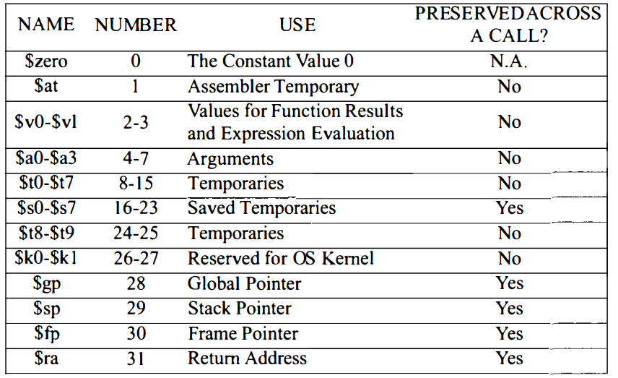
Registers and Opcodes
Source: Card-P374493.indd

Slide 20
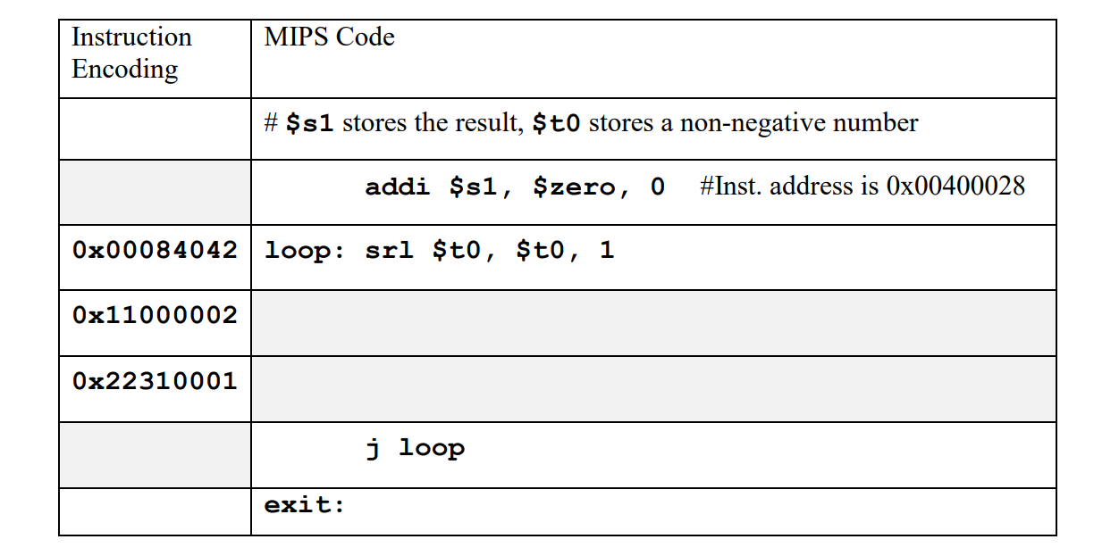
Q2 MIPS and Instruction Encoding

Slide 21
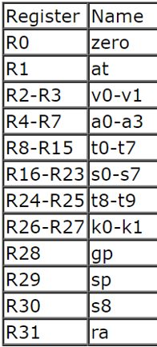
Q2 MIPS and Instruction Encoding
addi $s1, $zero, 0
I-Format
= 0x20110000
opcode
rs
rt
immediate
6 bit
5 bit
5 bit
16 bit
addi
R0
R17
0
0010 00
00 000
1 0001
0000 0000 0000 0000

Slide 22
Q2 MIPS and Instruction Encoding
0x20110000

Slide 23
Q2 MIPS and Instruction Encoding
0x11000002
I-Format
opcode
rs
rt
immediate
6 bit
5 bit
5 bit
16 bit
0001 00
01 000
0 0000
0000 0000 0000 0010
beq
R8
R0
2

Slide 24
Q2 MIPS and Instruction Encoding
0x20110000
PC + 4

Slide 25
Q2 MIPS and Instruction Encoding
0x11000002
I-Format
beq $t0, $zero, exit
opcode
rs
rt
immediate
6 bit
5 bit
5 bit
16 bit
0001 00
01 000
0 0000
0000 0000 0000 0010
beq
R8
R0
2

Slide 26
Q2 MIPS and Instruction Encoding
0x20110000
beq $t0, $zero, exit

Slide 27
Q2 MIPS and Instruction Encoding
0x22310001
I-Format
addi $s1, $s1, 1
opcode
rs
rt
immediate
6 bit
5 bit
5 bit
16 bit
0010 00
10 001
1 0001
0000 0000 0000 0001
addi
R17
R17
1

Slide 28
Q2 MIPS and Instruction Encoding
0x20110000
beq $t0, $zero, exit
addi $s1, $s1, 1

Slide 29
Q2 MIPS and Instruction Encoding
j loop
J-Format
The actual address to jump to:
opcode
target address
000010
26 bit
1st 4 bit of (PC+4)
Target address
00
Notes:
Note the address of loop, and the address of PC+4, which is exit:
They need to have the same 1st 4 bits in binary, or the same 1st bit in hexadecimal

Slide 30
Q2 MIPS and Instruction Encoding
0x20110000
0x0040002C
beq $t0, $zero, exit
0x00400030
addi $s1, $s1, 1
0x00400034
0x00400038
0x0040003C
Notes:
Note the address of loop, and the address of PC+4, which is exit:
They need to have the same 1st 4 bits in binary, or the same 1st bit in hexadecimal

Slide 31
Q2 MIPS and Instruction Encoding
j loop
J-Format
The actual address to jump to:
= 0x0810000B
1st 4 bit of (PC+4)
Target address
00
0000
0000 0100 0000 0000 0000 0010 11
00
0X0 0 4 0 0 0 2 C
opcode
target address
0000 10
00 0001 0000 0000 0000 0000 1011

Slide 32

Q2 MIPS and Instruction Encoding
$t0 | 7 | 3 | 1 | 0
$s1 | 0 | 1 | 2
$$\$s1=\left\lfloor \log_{2}(\$t0)\right\rfloor$$
0x20110000
0x0040002C
beq $t0, $zero, exit
0x00400030
addi $s1, $s1, 1
0x00400034
0x0810000B
0x00400038
Notes:
Now examine the relationship between t0 and s1
floor, round down, truncation

Slide 33
Q3 C to MIPS again
array[0] -> $s0
target → $s1
low → $s2
high → $s3
mid → $s4
ans → $s5
If high < low, $t9 = 1.
If $t9 == 0, loop
If $t9 <> 0, exit
loop: slt $t9, $s3, $s2
bne $t9, $zero, end
// some code here
end:
while (low <= high) {
mid = (low + high) / 2
t1 = array[mid]
if (target < t1)
high = mid – 1;
else if (target > t1)
low = mid + 1;
else {
ans = mid;
break;
}
}
Notes:
while (low <= high) is equivalent to if (high < low) exit

Slide 34
Q3 C to MIPS again
array[0] -> $s0
target → $s1
low → $s2
high → $s3
mid → $s4
ans → $s5
loop: // loop conditions code
add $s4, $s2, $s3
srl $s4, $s4, 1
// some code here
end:
while (low <= high) {
mid = (low + high) / 2
t1 = array[mid]
if (target < t1)
high = mid – 1;
else if (target > t1)
low = mid + 1;
else {
ans = mid;
break;
}
}

Slide 35
Q3 C to MIPS again
array[0] -> $s0
target → $s1
low → $s2
high → $s3
mid → $s4
ans → $s5
loop: // loop conditions code
// storing mid in $s4
sll $t0, $s4, 2
add $t0, $s0, $t0
lw $t1, 0($t0)
end:
while (low <= high) {
mid = (low + high) / 2
t1 = array[mid]
if (target < t1)
high = mid – 1;
else if (target > t1)
low = mid + 1;
else {
ans = mid;
break;
}
}
Notes:
to get int from array by index, we use base address

Slide 36
Q3 C to MIPS again
array[0] -> $s0
target → $s1
low → $s2
high → $s3
mid → $s4
ans → $s5
loop: // loop conditions code
// storing mid in $s4
// storing array[mid] in $t1
slt $t9, $s1, $t1
beq $t9, $zero, bigger
addi $s3, $s4, -1
j loopEnd
bigger:
loopEnd:
end:
while (low <= high) {
mid = (low + high) / 2
t1 = array[mid]
if (target < t1)
high = mid – 1;
else if (target > t1)
low = mid + 1;
else {
ans = mid;
break;
}
}

Slide 37
Q3 C to MIPS again
array[0] -> $s0
target → $s1
low → $s2
high → $s3
mid → $s4
ans → $s5
loop: // loop conditions code
// storing mid in $s4
// storing array[mid] in $t1
// smaller condition code
bigger:
slt $t9, $t1, $s1
beq $t9, $zero, equal
addi $s2, $s4, 1
j loopEnd
equal:
loopEnd:
end:
while (low <= high) {
mid = (low + high) / 2
t1 = array[mid]
if (target < t1)
high = mid – 1;
else if (target > t1)
low = mid + 1;
else {
ans = mid;
break;
}
}
Notes:
check if t1 is smaller than target, if not smaller, go to equal

Slide 38
Q3 C to MIPS again
array[0] -> $s0
target → $s1
low → $s2
high → $s3
mid → $s4
ans → $s5
loop: // loop conditions code
// storing mid in $s4
// storing array[mid] in $t1
// smaller condition code
// bigger condition code
equal:
add $s5, $s4, $zero
j end
loopEnd:
end:
while (low <= high) {
mid = (low + high) / 2
t1 = array[mid]
if (target < t1)
high = mid – 1;
else if (target > t1)
low = mid + 1;
else {
ans = mid;
break;
}
}

Slide 39
Q3 C to MIPS again
target → $s1
low → $s2
high → $s3
mid → $s4
ans → $s5
loop: // loop conditions code
// storing mid in $s4
// storing array[mid] in $t1
// smaller condition code
// bigger condition code
// equal condition code
loopEnd:
j loop
end:
while (low <= high) {
mid = (low + high) / 2
t1 = array[mid]
if (target < t1)
high = mid – 1;
else if (target > t1)
low = mid + 1;
else {
ans = mid;
break;
}
}

Slide 40
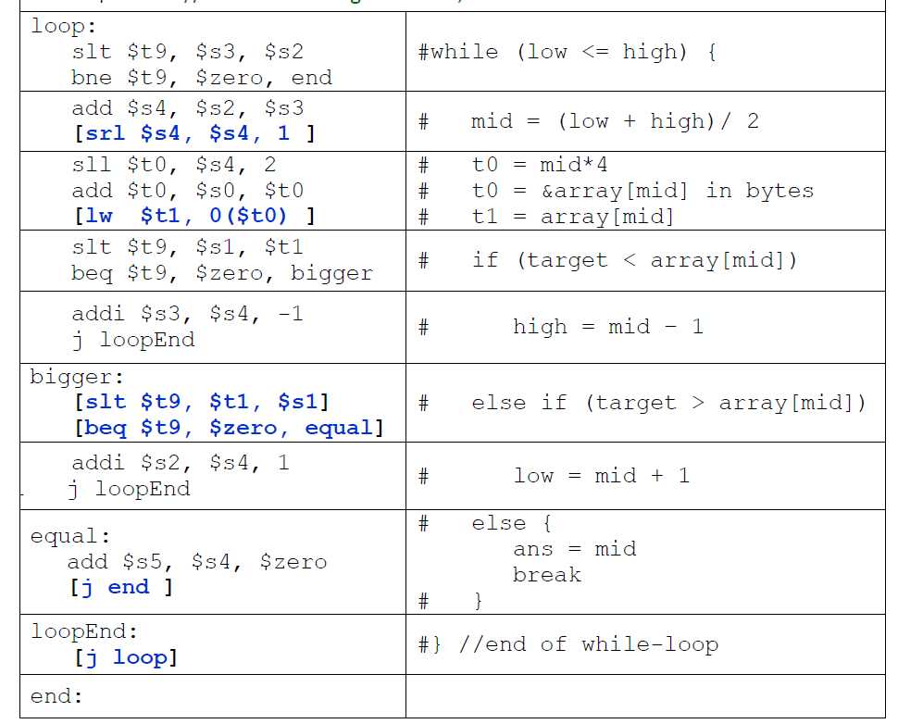
Q3
PC + 4
b. immediate value for
bne $t9, $zero, end
Label end is 16 instructions away from PC + 4.
The immediate value is 16.
Notes:
labels do not count as a separate instruction

Slide 41
Q3
0xFFFFFF00
c. hexadecimal representation of
j loopEnd
Address at loopEnd: is
0xFFFFFF00 + (17₁₀×4) =0xFFFFFF44
1111 1111 1111 1111 1111 1111 0100 0100
Check that the most significant 4 bit of address after j loopEnd is also 0b1111.
000010 1111 1111 1111 1111 1111 0100 01
=0x0BFFFFD1
PC + 4
0xFFFFFF44

Slide 42
Q3
0xFFFFFF00
d. The encoding of the 2nd
j loopEnd
Check that the most significant 4 bit of address at the 2nd j loopEnd is still 0b1111.
Then yes, we have the same encoding as the 1st j loopEnd.
Jump specifies the target “directly”. So, two jumps to the same target will give the same encoding.
0xFFFFFF44

Slide 43
Backup – How to Jump out of The Block
Not covered, just fyi
Store the address to be jumped to in a register.
Jump to the address stored in the register using instruction jr
lui $t0, 0x1000
ori $t0, 0xFFFF
jr $t0 // jump to 0x1000FFFF

Slide 44
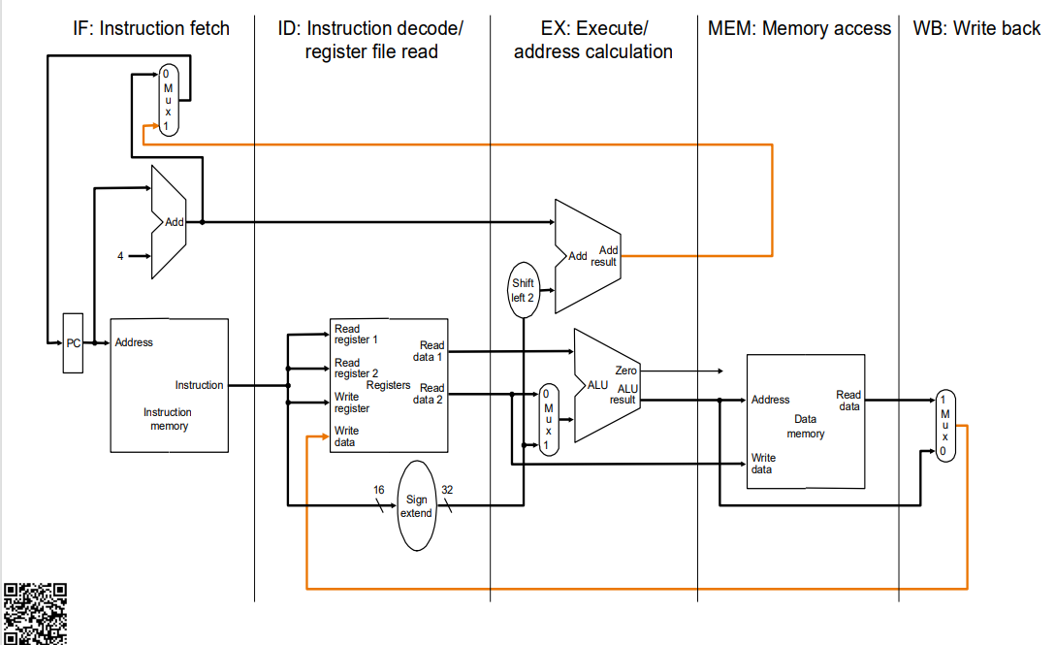
Backup – MIPS Pipeline
PC + 4 + Immediate * 4
PC + 4
Immediate * 4
Notes:
PC is used to fetch instruction, and also at around the same time, we calculate PC + 4, if we have further branching from the instruction, we use PC + 4 as the operand, and add it with the immediate value.

Slide 45
Backup
Card-P374493.indd
JumpAddr = { PC+4[31:28], address, 2’b0 }
BranchAddr = {14{immediate[15]},immediate,2’b0}
xori – opcode: 001110
xor – funct: 100110
Notes:
https://courses.cs.washington.edu/courses/cse410/10sp/MIPS%20Green%20Card.pdf
Card-P374493.indd
xori is I format, funct is 0
xor is R format, opcode is 0

Slide 46
CS2100 Tutorial 3
Song Kai
song.kai@u.nus.edu

